Slide 1
FlixFinder Application
Jude Orsua
Sabrina Gonzalez

Slide 2
System Description
Our application is a show/movie recommendation and finder based on a variety of criteria from different shows available on Netflix
Terminal use with python code
With the many titles involved a user can:
Search for a specific movie title
Filter a show recommendation based on different criterias
Add shows to a favorite list and view the list
Have a random show be recommended to them

Slide 3
Implementation Details
Database
Chosen off of Kaggle - https://www.kaggle.com/shivamb/netflix-shows
All shows All TV Shows and Movies metadata on Netflix
Details such as - cast, directors, ratings, release year, duration, title, country, date added, genre, and description
Implementation
We utilized Python to include the database we created
For the application, we used the Python terminal
Through the terminal, users can search, filter, add to favorites, and see a random title recommendation

Slide 4
Most Important Use-Cases
User Use Cases
Add to a favorite list
Choose how they would like their search to be filtered
Search for a specific title to see it is in the library
FilxFinder Use Cases
Keep record of liked titles while using the application
Filter a recommendation based on different criterias
Generate a random show be recommended to the user

Slide 5

Use -Case Description
FlixFinder Application
Search
Uses
Genre
Rating
Uses
Uses
Uses
Release Date
Recomme-ndation
User
Filter
Extend
Uses
Favorite
Random
Uses

Slide 6
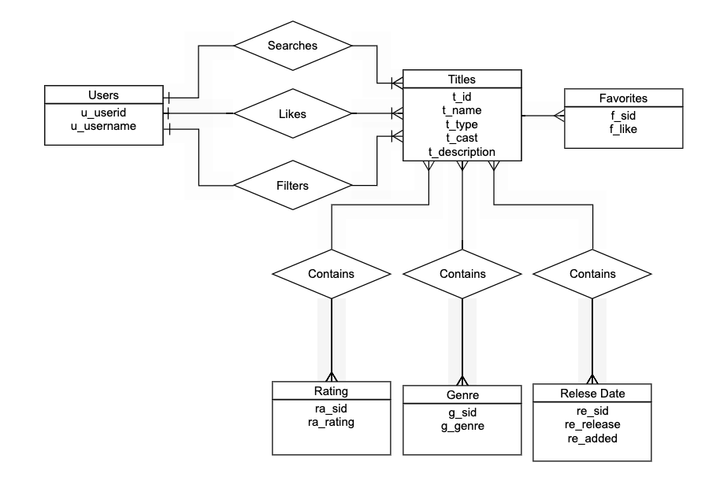
ER Diagram + Relational Schema

Slide 7
Demo

Slide 8
Repository
https://github.com/SabrinaGonz/DatabaseSystems-Project

